Slide 1

Chris Woodruff
LearningAbout.Dev
Level: Intermediate, etc.

Slide 2

Documenting your API with OpenAPI
Learn to Produce Effective Web APIs with ASP.NET 5

Slide 3
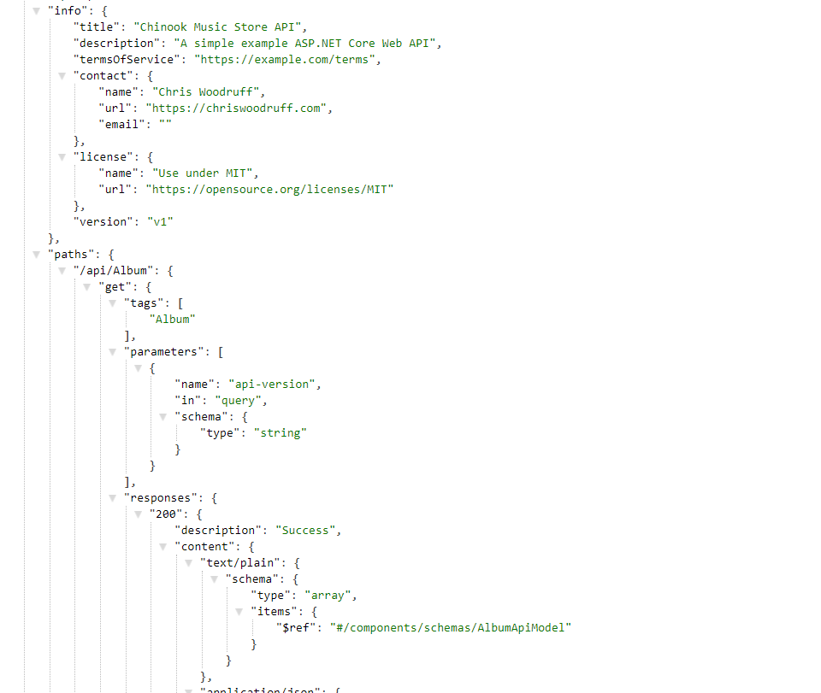
Example of an OpenAPI Document

Slide 4
OpenAPI vs Swagger
OpenAPI is a specification
Swagger is the tooling for OpenAPI

Slide 5
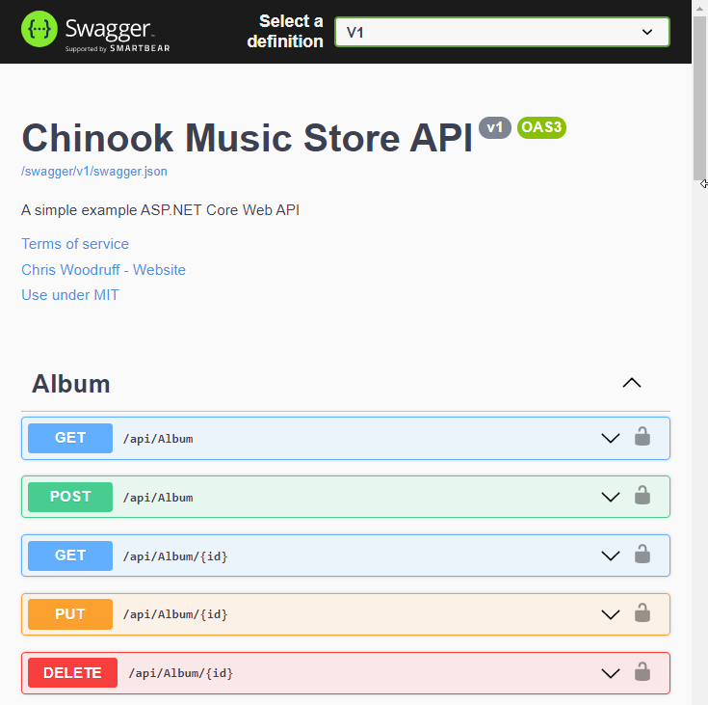
Swagger UI

Slide 6
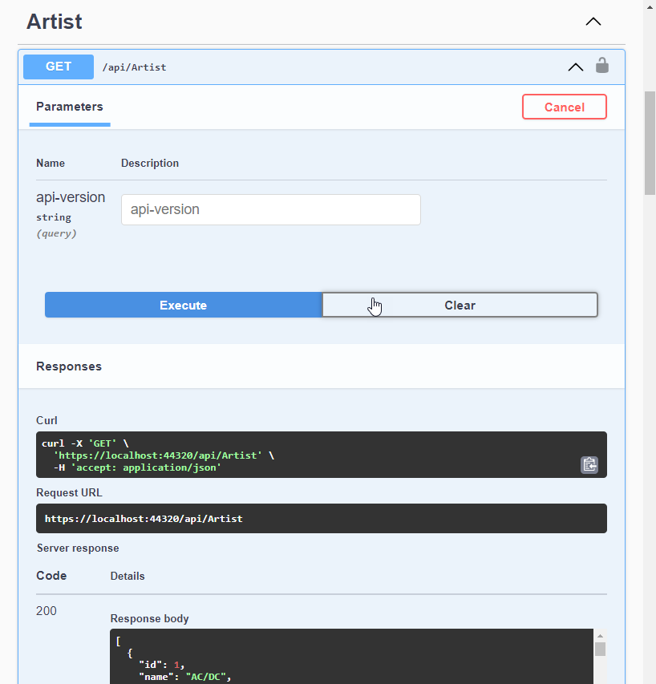
Swagger UI

Slide 7
Parts of Swagger
Swagger Component | Details
Swashbuckle.AspNetCore.Swagger | Object model and middleware to expose SwaggerDocument objects as JSON endpoints
Swashbuckle.AspNetCore.SwaggerGen | Generator that builds SwaggerDocument objects directly from your routes, controllers, and models.
Swashbuckle.AspNetCore.SwaggerUI | Embedded version of the Swagger UI tool. It interprets Swagger JSON to build a rich, customizable experience for describing the web API functionality.

Slide 8

We will learn to fix Swagger with Versioning!!

